Slide 1

Group 14
Aarush, Gautam, Eric, Victoria, Emily, Srideep, Carl, Mark, Nilay, Travis

Slide 2
Statement of purpose
Create an application that features a collection of games that are both fun and functional
Design games such as matching card games, sequence memory challenges, and reaction time tests that will not only entertain our users but also provide meaningful benchmarks of human performance
Our platform will be designed to be accessible for all age groups
Our platform will be engaging for users with a wide range of interests
The application will have customization features to allow users to make it the experience they want
We strive to deliver reliable, smooth gameplay with robust backend logic

Slide 3

Risks and Rabbit Holes

Slide 4
Concurrency
No one on our team has prior experience in online game development and choosing an idea that will require concurrent sessions and data transfer between users is most likely out of our expertise
Additionally, this runs the risk of a bad user experience due to our inability to protect against exploits

Slide 5
Solution:
Design the product to be entirely local or turn-based/asynchronous where possible. Focus on single-user or "hot seat" local play. If online features are needed, restrict them to non-critical functions like posting final scores/leaderboard.

Slide 6

Non-local processing
For UX and feasibility purposes, we want to focus on experiences that can run well locally, and only call home to the server or require serve computation/load when needed instead of every time
This allows the user to have a faster, low latency experience
This also reduces hosting costs on our side

Slide 7
Solution:
Architect the game so core gameplay logic happens fully on the client. Use the server only for occasional updates like posting leaderboard scores or syncing game saves. Always prioritize fast, responsive local interactions.

Slide 8
Complicated UI
We have a talented front end team
We should try not to get too ambitious with our visuals to the point that our backend logic and application stability falls through
We should also keep the end user in mind, and consider whether our target audience wants the UI features we are capable of developing or not

Slide 9
Solution:
To work around this issue, the UI/UX team will continue to be consistent with the simple, yet neat designs, just like the Warm-Up activity. We will do research to find existing leaderboard and game designs that are simple but also elevate it to cater our project. By combining our own ideas with inspiration we find through research, we can prioritize enhancing the UI/UX experience and allow for a backend that would not be too complicated to develop.

Slide 10





Scalability obsession
Since our idea is more of a platform of multiple card games, we shouldn't become obsessed with making multitudes of games.
This will spread our focus
It will reduce the depth of technical features we can support
It will also take us away from the main goal of creating a game that is flushed out with all its features.
Quality > Quantity

Slide 11
Solution:
Focus on building 1-2 polished games that feel complete and fun. Build the platform with future extensibility in mind but defer adding new games until the core experience is fully stable and enjoyable.

Slide 12
Leaderboards
One of the features that our group is excited to learn about and work on is leaderboards
We should keep our expectations realistic.
None of us have experience in doing this, so there is a high time/effort risk
We must remember that while simple leaderboards help support the game, complicated leaderboards only add a minimal amount to the user experience

Slide 13
Solution:
Implement a simple leaderboard first (just top 10 scores with basic player names and scores) using server-side storage. Expand features (filters, history, rankings) only if time allows and user need is clear.

Slide 14

User personas

Slide 15
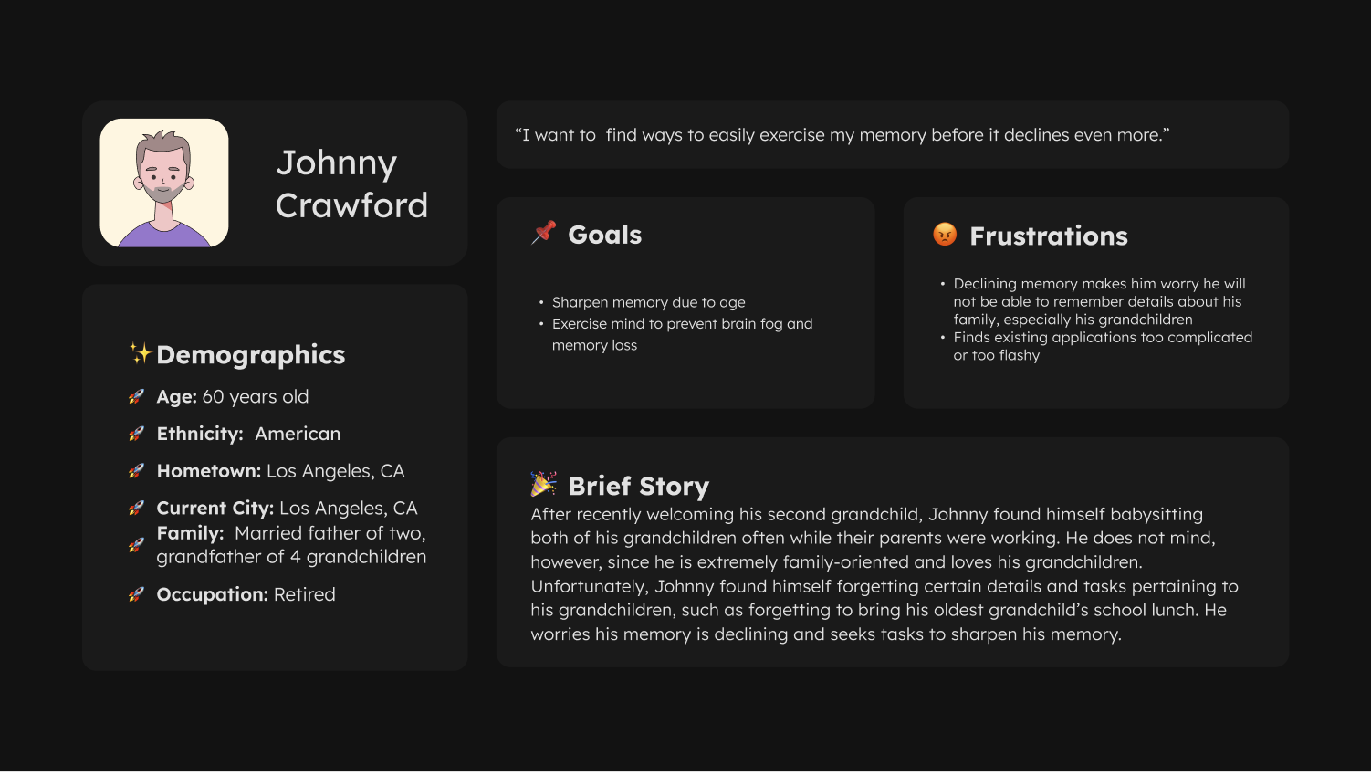

Slide 16
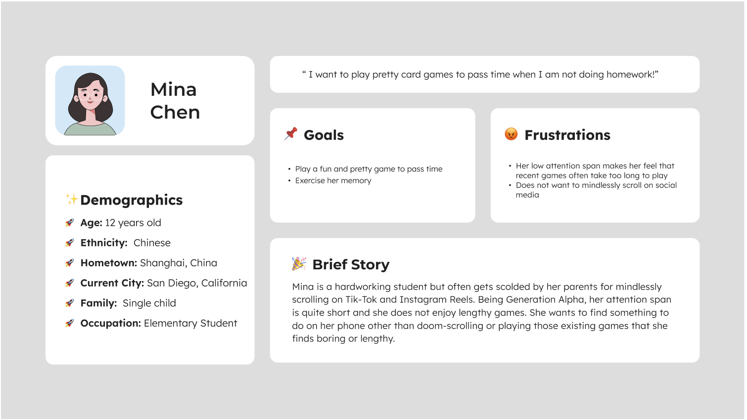

Slide 17
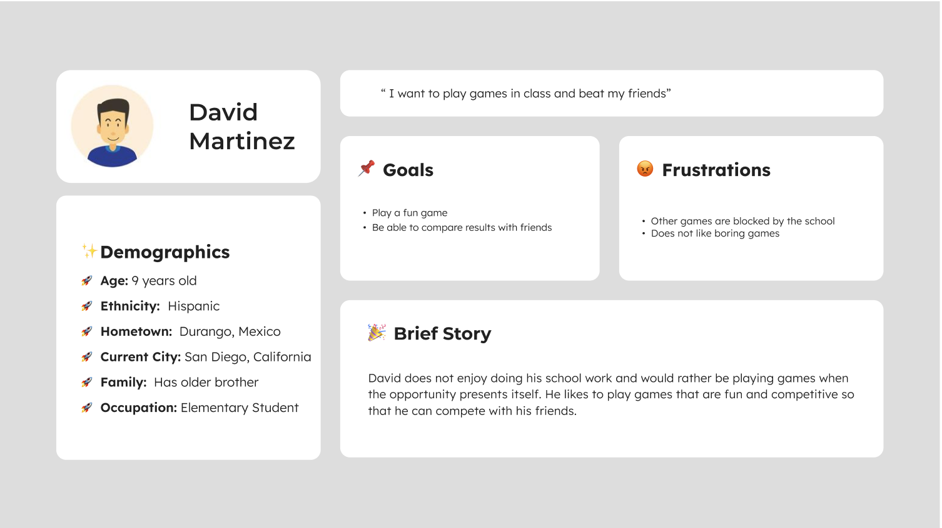

Slide 18


Slide 19
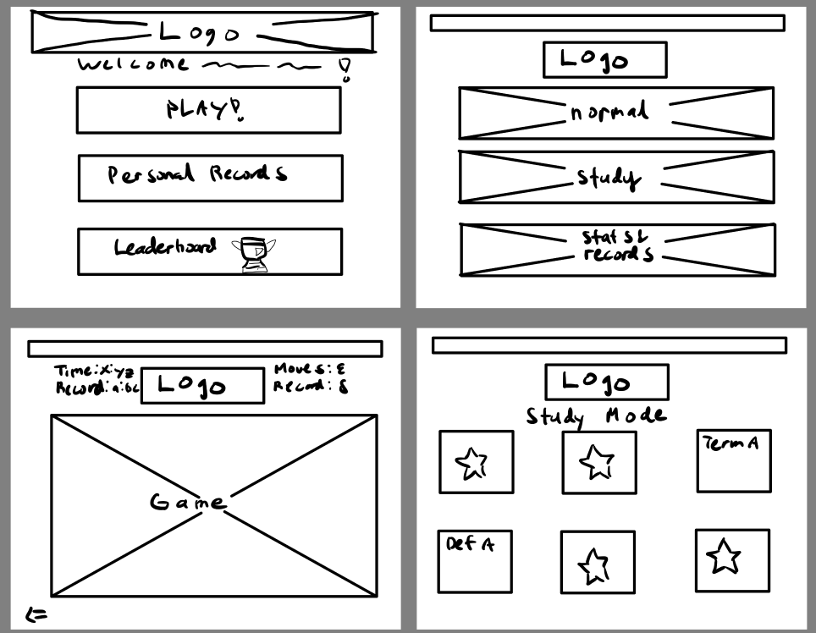
Wireframes

Slide 20
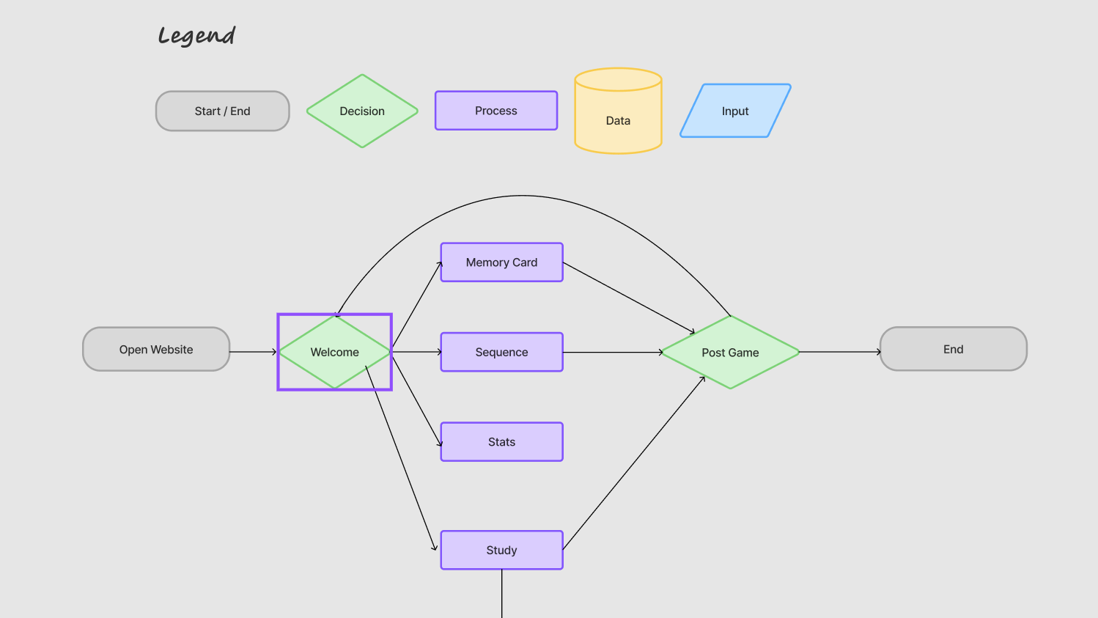
System diagram

Slide 21
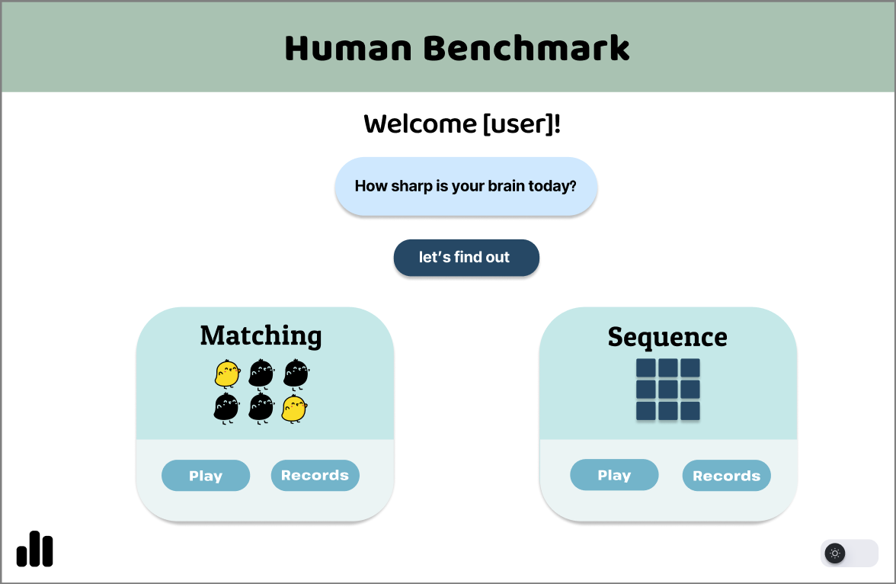
Visual Mock-Up: Homepage

Slide 22
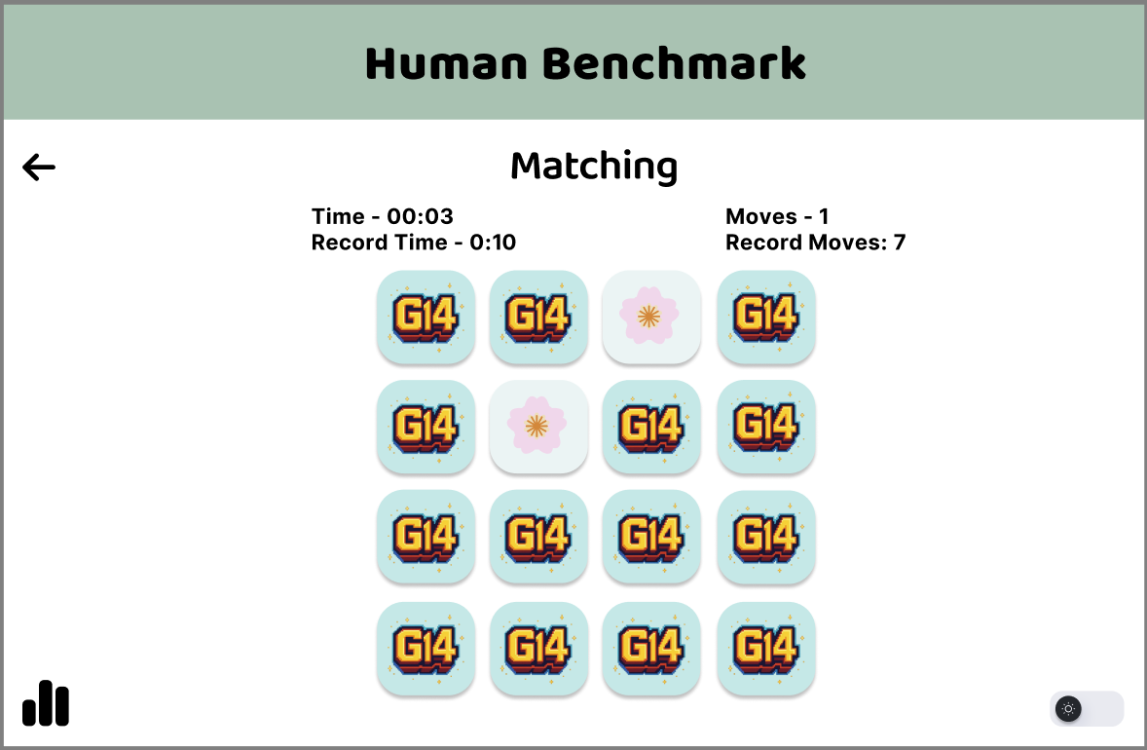
Matching Game and features

Slide 23
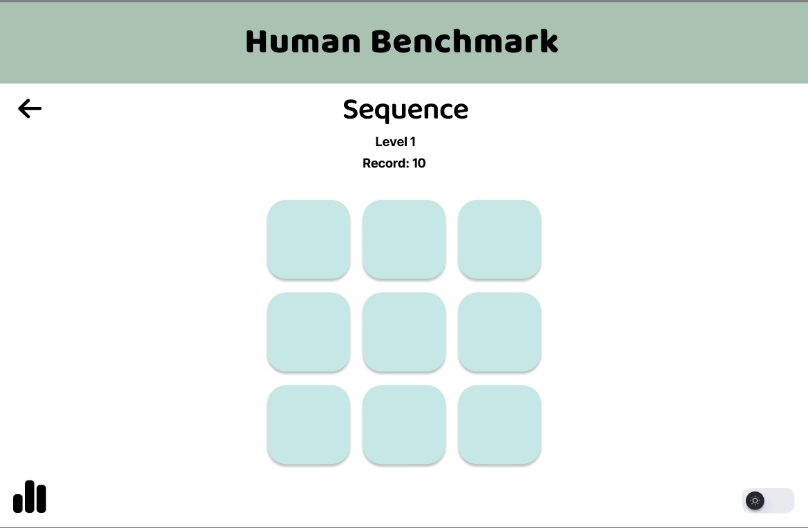
Visual Mock-Ups: Sequence memory game

Slide 24
Project roadmap
In Depth Planning and Research Phase (2 - 3 days)
Select Key Game that we want to implement (Matching Cards Game)
Research Base Tech Stack for similar games/sites
Set an MVP
Homepage + 1 mini game + records tracking + local leaderboard
Thorough Front-End leaning into team strengths
Start Developing MVP (1 week)
Implement Finalized Design of Homepage shown previously
Focus on page navigation and ease of use
Develop our Key Game
Add localized leaderboard once game logic is working
Scale Up # of games once MVP is fully flushed out (2 weeks)
Sequence Memory Game
Reaction Time Game
Joint leaderboard
Conduct Thorough testing from User Personas’ perspective (2 days)
Beautify UI and overall Frontend (1 week)
Start implementing extra features like the customization of cards/themes and dark mode
Add intricate animations
Overall Testing (remaining time)

